Slide 1
New QCE System
From 2019 onwards for Year 9 into 10 and Year 10 into 11
Bundaberg State High School expects all students who graduate to attain
a QCE or QCIA that leads to/enhances their chosen pathway.

Slide 2
Year 9 into 10
Year 9 is the final year of Junior Secondary and is starting preparation for success in Senior Secondary.
Year 10 is the preparation phase for successful transition into Year 11 and the new QCE system.
Therefore, by the end of Year 10, a clear understanding of the best suited pathway for each student to achieve success.
Bundaberg State High School expects all students who graduate to attain
a QCE or QCIA that leads to/enhances their chosen pathway.

Slide 3
Year 10 into 11, 2019
Bundaberg State High School expects all students who graduate to attain
a QCE or QCIA that leads to/enhances their chosen pathway.

Slide 4
Expectations of Senior Secondary
Expect all students who graduate to attain a QCE or QCIA that leads to/enhances their chosen pathway.
Post-compulsory Phase of Schooling (Year 11)
Required to meet school expectations – attendance; performance; behaviour
Bundaberg State High School expects all students who graduate to attain
a QCE or QCIA that leads to/enhances their chosen pathway.

Slide 5
School Responsibilities
Set students up for success
Consider – Year 10 results, study habits, out of school commitments
Choose courses based on career pathway and demonstrated performance in subjects
Provide support/structure for students who ensure they have opportunities that support best performance
Staff scaffold experiences, provide extra support, maintain parent communication
Goal setting practices – fundamental to student performance
Bundaberg State High School expects all students who graduate to attain
a QCE or QCIA that leads to/enhances their chosen pathway.

Slide 6
Student responsibilities
Choose courses that suit dedication level
Eg If too many sport/family commitments, poor study habits, DO NOT choose General subjects (minimum of 30 minutes per subject per night)
Personal responsibility for learning
Understand criteria, expectations for class work, assessment processes, expectations for performance, track performance
Work commitments
12-15 hours maximum. More than 25 hours = full time employment
KEEP YOUR OPTIONS OPEN – BEST RESULTS MEAN BETTER OPTIONS LATER
Bundaberg State High School expects all students who graduate to attain
a QCE or QCIA that leads to/enhances their chosen pathway.

Slide 7
Parent Responsibilities
Understand
Skill requirements for chosen courses
Study implications of chosen courses
Requirements for Senior enrolment
Work with us to ensure students
Negotiate best course options (based on performance – minimum standards)
Meet minimum requirements for QCE
Perform to the best of their ability
Bundaberg State High School expects all students who graduate to attain
a QCE or QCIA that leads to/enhances their chosen pathway.

Slide 9
Part 1 – Subjects and ATAR eligibility
Bundaberg State High School expects all students who graduate to attain
a QCE or QCIA that leads to/enhances their chosen pathway.

Slide 10
Expectations
Expectation that ALL students will study:
6 subjects
an English and a Mathematics
NO subject changes after end Term 3 2020 (Year 11)
Minimum 92% attendance except extenuating circumstances (such as long-term illness)
Submit ALL assessment
Assessment is submitted by the due date or completed on the set date unless extenuating circumstances (medical certificate required).
Bundaberg State High School expects all students who graduate to attain
a QCE or QCIA that leads to/enhances their chosen pathway.

Slide 11
Pathways depending on subject choices
University (ATAR)
Receive a rank from 99.95 (highest) to 30 (lowest)
Tertiary Options (University & TAFE)(ATAR)
Receive a rank from 99.95 (highest) to 30 (lowest)
Other Pathway – Work or Study at TAFE/Other External Agency
Bundaberg State High School expects all students who graduate to attain
a QCE or QCIA that leads to/enhances their chosen pathway.

Slide 12
New QCE system
Subjects are classified into:
General
Year 12 – 3 Internal Assessments (IA) and 1 External Assessment (EA)
Receive a result out of 100 and an A-E result
Applied
Receive an A-E result
Vocational Education (VET)
Receive Qualification or Statement of Attainment
The School will also offer subjects as part of the Special Education Program which lead to a QCIA.
Bundaberg State High School expects all students who graduate to attain
a QCE or QCIA that leads to/enhances their chosen pathway.

Slide 13
For ATAR eligibility (University/Tertiary Options) (University application in Year 12)
five General subjects
OR
four General subjects and one Applied subject
OR
four General subjects and one VET subject completed at Certificate III or higher
AND
complete a QCAA English subject at a C or better standard. However, a student’s result in English will only contribute to their ATAR if it is one of their five best subject results.
Bundaberg State High School expects all students who graduate to attain
a QCE or QCIA that leads to/enhances their chosen pathway.

Slide 14
Tertiary Pre-requisites
Google QTAC
Select ATAR
Select My Path then scroll down for links to Universities with the list of pre-requisites
https://www.qtac.edu.au/atar-my-path/my-path
Bundaberg State High School expects all students who graduate to attain
a QCE or QCIA that leads to/enhances their chosen pathway.

Slide 15
Other Pathway
Do not meet the ATAR eligibility requirements
Knowledge/Skills that match preferred pathway post-Year 12
Bundaberg State High School expects all students who graduate to attain
a QCE or QCIA that leads to/enhances their chosen pathway.

Slide 16
General Subjects
All subjects have 3 internal assessments and 1 external assessment
All results from Units 3 and 4 contribute to ATAR Rank
Year 11 Units 1 and 2 are formative and do not contribute to ATAR Rank however do contribute to QCE Points
External assessments take place in Year 12 Term 4 weeks 4 to 7
General subjects in Mathematics and Science categories have 50% External Assessment
Results out of 100 and an overall A-E result
Bundaberg State High School expects all students who graduate to attain
a QCE or QCIA that leads to/enhances their chosen pathway.

Slide 17
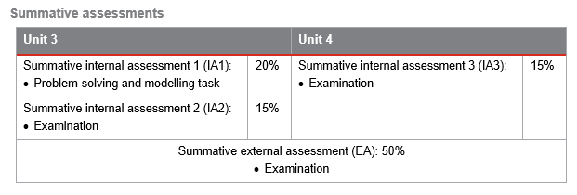
General Subjects (examples see staff for other subjects)
English
General Mathematics

Slide 18
Applied Subjects
1 subject may contribute to ATAR Rank
Essential English and Essential Mathematics have a Common Internal Assessment (CIA) – written by QCAA and completed at School
Results are reported at A-E
Bundaberg State High School expects all students who graduate to attain
a QCE or QCIA that leads to/enhances their chosen pathway.

Slide 19
Applied Subjects (examples see staff for other subjects)
Essential English
Essential Mathematics

Slide 20
Vocational Education & Training (VET) courses
1 completed Certificate III level course can contribute to ATAR Rank
Few Certificate II and Certificate III level courses available
Reports are based on course completion ie On Track, Working towards, Significantly behind
Some of the courses (from outside Providers ie TAFE, Binancle …) are VETiS funded which means the courses are free however, only receive one opportunity at this funding (one bite at the cherry)
Bundaberg State High School expects all students who graduate to attain
a QCE or QCIA that leads to/enhances their chosen pathway.

Slide 21
Vocational Education & Training (VET) courses
Delivered either
At school in timetabled classes
Outside providers eg TAFE Students attend courses outside of school in school hours
As part of School-based Traineeship or Apprenticeship
Application for enrolment into a VET program will be issued during Career Development or Access lesson
Bundaberg State High School expects all students who graduate to attain
a QCE or QCIA that leads to/enhances their chosen pathway.

Slide 22
Part 2 – QCE/QCIA
Bundaberg State High School expects all students who graduate to attain
a QCE or QCIA that leads to/enhances their chosen pathway.

Slide 23
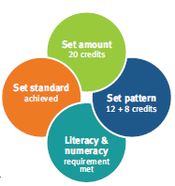
What is a QCE?
QCE – Queensland Certificate of Education
The QCE is Queensland’s senior secondary schooling qualification. To be issued with a QCE, students need to
Complete the set amount of learning
At the set standard
In a set pattern
Meet literacy and numeracy requirements
Bundaberg State High School expects all students who graduate to attain
a QCE or QCIA that leads to/enhances their chosen pathway.

Slide 24
What is a QCIA?
QCIA – Queensland Certificate of Individualised Learning
The QCIA recognises the achievements of student who undertake individualised learning programs. To be eligible, students must have impairments or difficulties in learning that are not primarily due to socioeconomic, cultural or linguistic factors.
Bundaberg State High School expects all students who graduate to attain
a QCE or QCIA that leads to/enhances their chosen pathway.

Slide 25
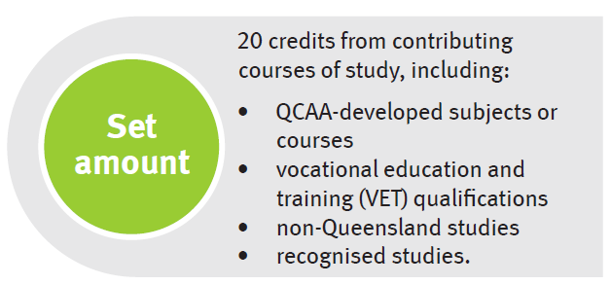
QCE requirements
Bundaberg State High School expects all students who graduate to attain
a QCE or QCIA that leads to/enhances their chosen pathway.

Slide 26
QCE requirements
Bundaberg State High School expects all students who graduate to attain
a QCE or QCIA that leads to/enhances their chosen pathway.

Slide 27
QCE requirements
Bundaberg State High School expects all students who graduate to attain
a QCE or QCIA that leads to/enhances their chosen pathway.

Slide 28
Set Pattern
QCAA General subjects and Applied subjects
Unit 1 completed at a satisfactory standard = 1 QCE credit
Unit 2 completed at a satisfactory standard = 1 QCE credit
Unit 3 and 4 pair must be completed at a satisfactory standard = 2 QCE credits
NOTE: satisfactory standard means “C” standard
Bundaberg State High School expects all students who graduate to attain
a QCE or QCIA that leads to/enhances their chosen pathway.

Slide 29
VET qualifications
Certificate II course (max 4) Certificate III and IV courses (max 8)
25% completion = 1 QCE credit 2 QCE credits
50% completion = 2 QCE credits 4 QCE credits
75% completion = 3 QCE credits 6 QCE credits
100% completion = 4 QCE credits 8 QCE credits
NOTE:
Complete only 1 Certificate I qualification.
Some Certificate I courses = 2 QCE points (such as Certificate I in Retail Services)
Others courses such as Certificate I in Construction or Manufacturing = 3 QCE points
Must complete 100% of the course to earn QCE points.

Slide 30
Bundaberg State High School expects all students who graduate to attain
a QCE or QCIA that leads to/enhances their chosen pathway.

Slide 31
QCE requirements
Literacy learning options:
English
Essential English
Completed Certificate II in Skills for Work and Vocational Pathways
Numeracy learning options:
Specialist Mathematics
Mathematical Methods
General Mathematics
Essential Mathematics
Completed Certificate II in Skills for Work and Vocational Pathways
Bundaberg State High School expects all students who graduate to attain
a QCE or QCIA that leads to/enhances their chosen pathway.

Slide 32
Duplication of learning
Applied subjects and Certificate II qualifications that have similar content and learning goals - only receive QCE credit from one. Such as
Sport and Recreation SIS20115 Certificate II in Sport and Recreation
Business Studies BSB20115 Certificate II in Business
Hospitality Practices SIT20316 Certificate II in Hospitality
Industrial Technology Skills MSM20516 Certificate II in Manufacturing Technology
Information and ICT20115 Certificate II in Information, Digital Media and
Communication Technology Technology
Bundaberg State High School expects all students who graduate to attain
a QCE or QCIA that leads to/enhances their chosen pathway.

Slide 33
How to choose subjects
Choose subjects that you enjoy
Choose subjects that lead to your chosen pathway (University, Tertiary, Employment) – Prerequisites are being met. General Mathematics and English required for University and Defence Forces (No Essential Maths or English)
Choose subjects that you do well in.
Talk with your Teacher, Guidance Officer or Head of Department and other students about the subject – do your own research
Don’t put all your eggs into one basket – have a plan A and a plan B
Don’t bite off more than you can chew – be sensible about the workload and the time you are willing to commit to your studies (taking into account other commitments eg sport, music, family …)
Following friends is not a good idea!!!
Bundaberg State High School expects all students who graduate to attain
a QCE or QCIA that leads to/enhances their chosen pathway.

Slide 34
Subject Selections
Year 11, 2020
Must select –
One English
One Mathematics
Select 4 other subjects from the following curriculum areas –
Languages - Japanese
Science
HASS
HPE
Technology
Arts
VET (Senior Schooling)
Year 10, 2020
Must select –
One English
One Mathematics
One Science
Select 3 other subjects from the following curriculum areas –
Languages - Japanese
HASS
HPE
Technology
Arts
Bundaberg State High School expects all students who graduate to attain
a QCE or QCIA that leads to/enhances their chosen pathway.

Slide 35
SET/JET Planning
Year 9 into 10
Will complete a Junior Education and Training Plan (JET Plan)
Discussion with Teacher and student – approximately 20 mins in duration
Occur last two days of this Term – 19 & 20 September (no Year 9 classes on these days)
Year 10 into 11
Thursday 5 September or Friday 6 September (no Year 10 classes on these days)
Meeting of parent/carer with student and Senior Coach – approximately 20 minutes in duration
Meetings in the Library
Bundaberg State High School expects all students who graduate to attain
a QCE or QCIA that leads to/enhances their chosen pathway.

Slide 36
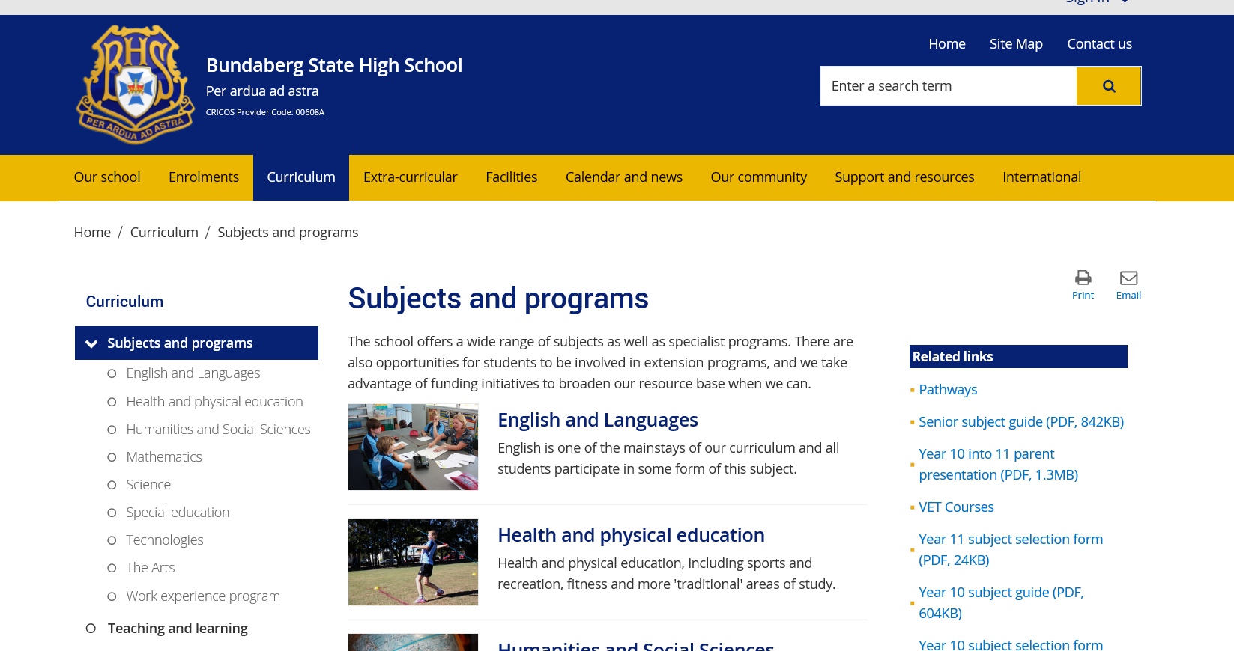

Slide 37
Bundaberg State High School expects all students who graduate to attain
a QCE or QCIA that leads to/enhances their chosen pathway.

