Slide 1
Interactive Voice Response (IVR)

Slide 2
BPOINT IVR
BPOINT IVR is a payment solution that enables business units and Schools to charge card payments via a Bank hosted IVR phone service in real-time achieving full PCIDSS compliancy.
1. Allow your customers to pay you anywhere, anytime with BPOINT’s customisable IVR system
2. BPOINT IVR is a payment solution that enables the merchant to process credit card or charge card payments via a Bank hosted IVR phone service in real-time
3. Real-Time notification response for every transaction
4. Automated payments receipts saves you time and reduces your admin costs
5. Allows the department to achieve Payment Card Industry Data Security Standard (PCIDSS) compliance

Slide 3
BPOINT IVR
Current Process
Process with BPOINT IVR
1. School or Business Unit receives a call from a customer to make a credit card payment over the phone
2. The staff member collects the card information on a piece of paper and enter the information into an EFTPOS machine.
3. The payment is processed and a manual receipt is entered into the relevant finance system (SAP/OneSchool)
4. The money from the card is settled and received into the bank account
5. This process is not PCIDSS compliant
1. School or Business Unit customer calls 1300 BPOINT to make a credit card payment over the phone
2. Customer enters their CRN, amount and card details to complete the payment
3. At the end of the call they are provided with a unique payment receipt number and the information is sent to the relevant finance system (SAP/OneSchool) for automated receipting
4. The money from the card is settled and received into the bank account
5. This process is PCIDSS compliant

Slide 4
BPOINT IVR
By providing customers with more ways to pay, you are helping your reconciliation and cash flow by ensuring that you receive your money on time and efficiently
1. The customer reads the payment options section of your invoice, which refers to a Biller Code(if applicable) and Customer Reference Number (CRN)
2. The customer then calls the Department’s 1300 number (School customers) or 1300BPOINT (Corporate customers) and is welcomed by the friendly BPOINT voice
3. They then enter the Biller Code (if applicable), and the merchant name is confirmed. Upon confirmation, customer enters their CRN, amount and card details to complete the payment
4. At the end of the call they are provided with a unique payment receipt number. They then have the option to make another payment
5. All successful payments are reported in a daily settlement report. The report can be used for reconciliation and uploading into SAP & OneSchool

Slide 5
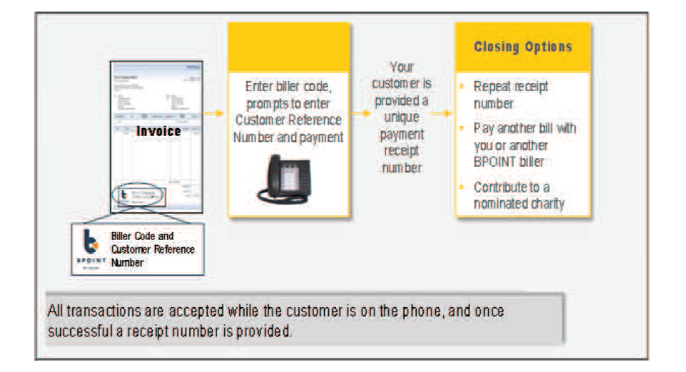
BPOINT IVR
Below is an overview of the process flow when paying via BPOINT IVR using a credit card

Slide 6
BPOINT IVR FAQs
What is BPOINT IVR?
IVR stands for Interactive Voice Response. This application is used by businesses across the world to collect card payments from their customers over the telephone.
Why does the department have to use BPOINT IVR?
To improve our customer experience and become PCIDSS compliant.
There is a major push by all banks including Commonwealth Bank of Australia and the card companies ( Visa/ MasterCard ) for organisations to become PCIDSS compliant.
What Is PCIDSS?
PCIDSS stands for Payment Card Industry Data Security Standard. The PCI Data Security Standards help protect the safety of payment card data.
Is BPOINT IVR compulsory?
Yes, BPOINT IVR is compulsory for Schools and Corporate users. Once implemented, no credit card payments will be taken over the phone unless they are processed via BPOINT IVR.
What if the department does not become PCIDSS compliant?
If the department does not become PCIDSS compliant, we may lose our merchant status and will not be able to collect payments from customer credit cards.

